Slide 1
Data Simulation
Miller 2015

Slide 2
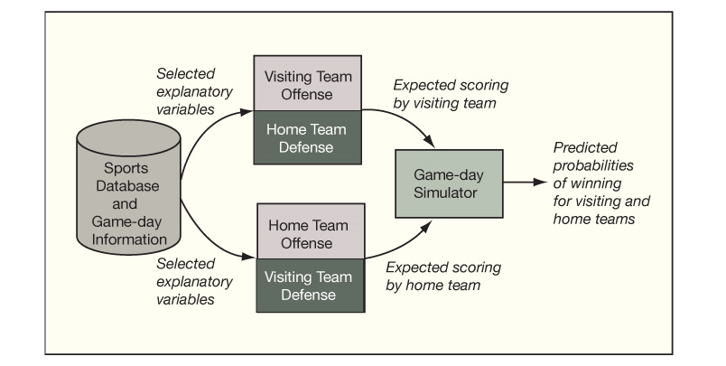
Predictive Modeling Framework for Picking a Winning Team

Slide 3
Game Day Simulation
Explanatory variables relate to past player and team performance.
These are used to predict runs or points scored by opposing teams.
We note where and when games are played and any other conditions that may affect game outcomes.

Slide 4
DriveRs of Success
Drivers of success for the Yankees may be different from the drivers of success for the Red Sox, the drivers for the Red Sox different from the Angels, the Angels different from the Indians, and so on.
For each team, the things that matter when playing at home may be different from the things that matter when playing away.
Various measures of win/loss strength and offensive and defensive performance may be used as explanatory variables.
Runs-scored models can be traditional or data-adaptive, or a combination of the two.

Slide 5
Question
How many runs can the Mets be expected to score against the Yankees when playing at Yankee Stadium? How many runs can the Yankees be expected to score? And, consequently, which team is expected to win these games?

Slide 6
Future Prediction from Past Events
To predict straight-up runs scored in the future, we start with runs scored in the past.
We select Mets’ and Yankees’ data for one season, ignoring team statistics from previous seasons and the 2007 preseason.
June 15 was the first meeting of the Mets and Yankees in the regular 2007 season, so we need to use runs scored against other teams.
For the Mets, we can select all Mets’ regular season away games between opening day in St. Louis with the Cardinals on May 1 to an away game on June 13 with the Los Angeles Dodgers. And for the Yankees, we can select all Yankees home games prior to June 15, which begin with the home opener with the Devil Rays on April 2 to a home game with the Diamondbacks on June 14.

Slide 7
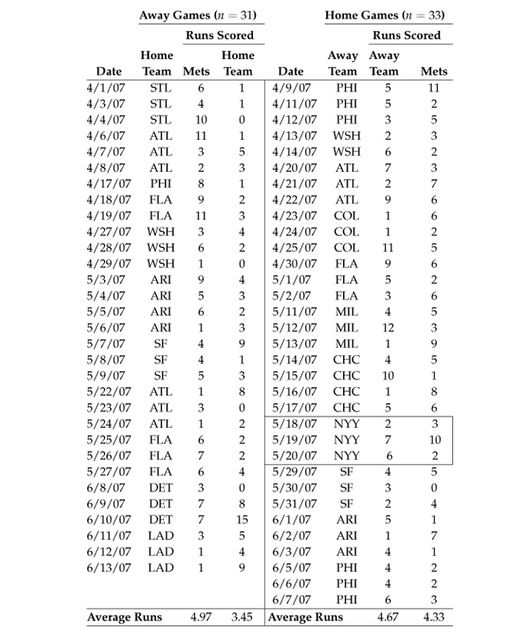
New York Mets’ Early Season Games in 2007

Slide 8
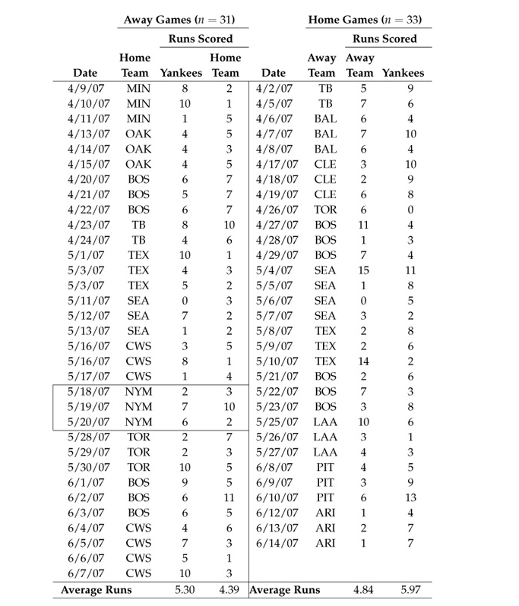
New York Yankees’ Early Season Games in 2007

Slide 9
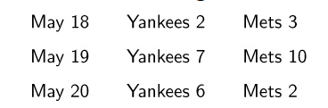
Early Season Games

Slide 10
Game Day Simulation
Game-day simulation uses data from real games in the past to generate data about hypothetical games, past and future.
Simulations are executed by computer. They utilize baseball statistics from the history of the game and its players.
Randomness is introduced by random number generators, so that playing the same game again and again provides a distinct outcome each time.

Slide 11
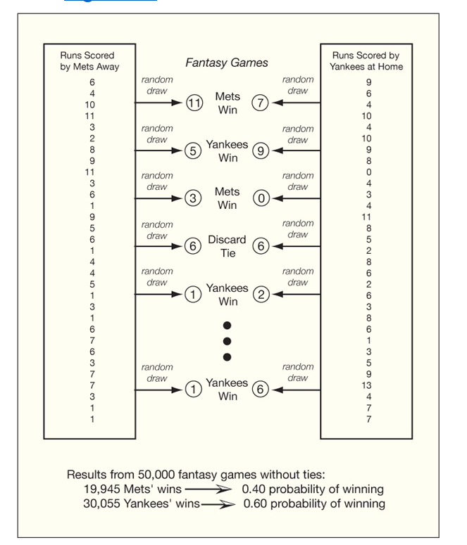
Fantasy Games
Notes:
Taking the lead from fantasy sports, we can create fantasy games with an objective to estimate the probability that one team will beat another.
For example, suppose we use a simple game-day simulation to pick the winning team in the June Mets-Yankees’ series. Drawing from the away runs-scored distribution of the Mets and the home runs-scored distribution of the Yankees on each playing of our fantasy game (each iteration of the simulation), we observe the runs scored by the Mets and the runs scored by the Yankees. If tied, we discard the observation. If the Mets’ score is higher than the Yankees’ score, we count a win for the Mets. If the Yankees’ score is higher than the Mets’ score, we count a win for the Yankees. Dividing the number of times the Mets win by the number of times we play the game without a tie provides an estimate of the probability of the Mets winning.
Dividing the number of times the Yankees win by the number of times we play the game without a tie gives an estimate of the probability of the Yankees winning, which is one minus the probability of the Mets winning.

Slide 12
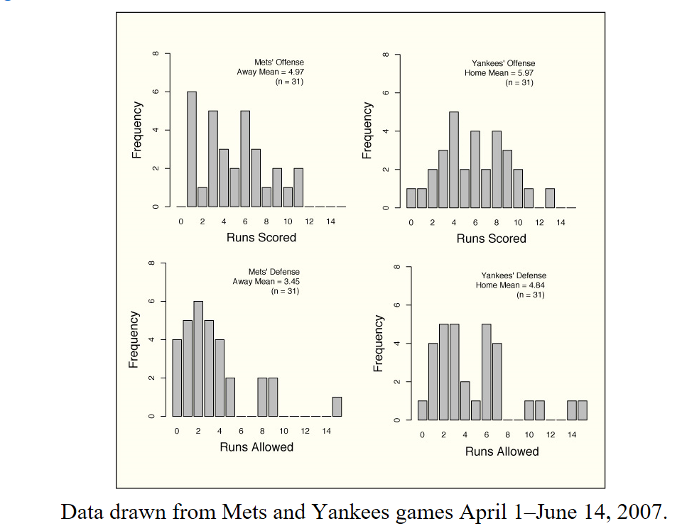
Mets’ Away and Yankees’ Home Data
Notes:
To get a better picture of how the Mets and Yankees stack up against each other, we juxtapose the teams’ offensive and defensive performance data. For games played at Yankee Stadium, we set the Mets’ away offense against the Yankees’ home defense and the Yankees’ home offense against the Mets away defense

Slide 13
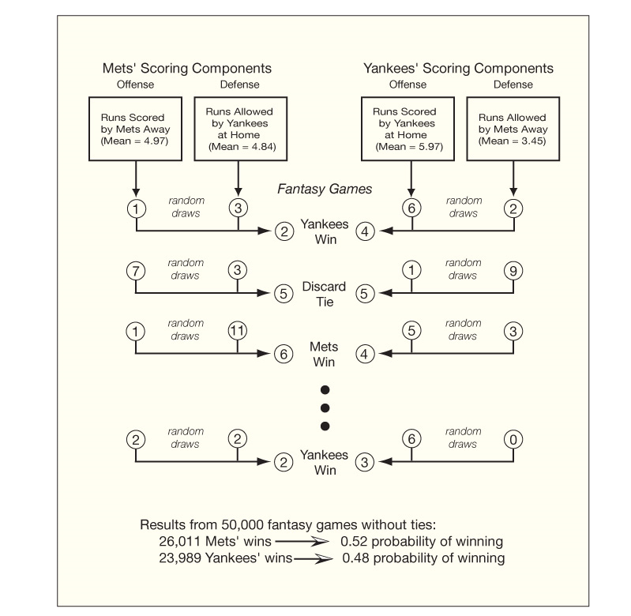
Balanced Game-day Simulation (offense and defense)

Slide 14
Poisson Distribution
When working with a count like the number of runs scored, it is convenient to employ probability distributions such as the Poisson distribution and the negative binomial distribution.
Using a Poisson distribution to represent runs scored, shutouts (zero runs scored) are viewed as rare events, especially for teams scoring an average of three or more runs per game.
Scores of more than twenty runs are also seen as rare events for teams scoring fewer than seven runs a game on average.

Slide 15
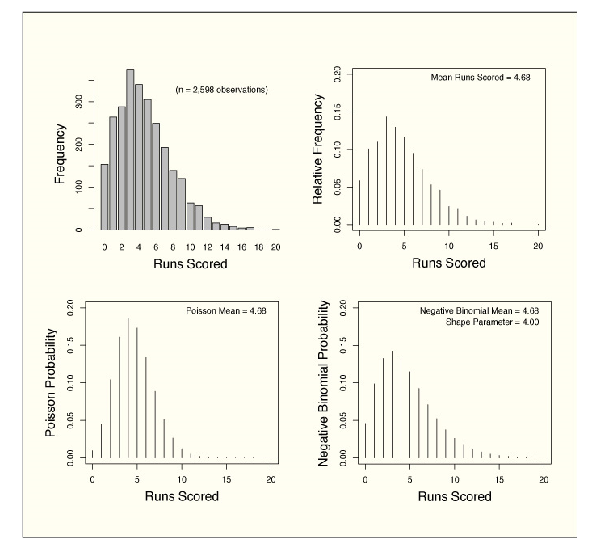
Actual and Theoretical Runs-scored Distributions

Slide 16
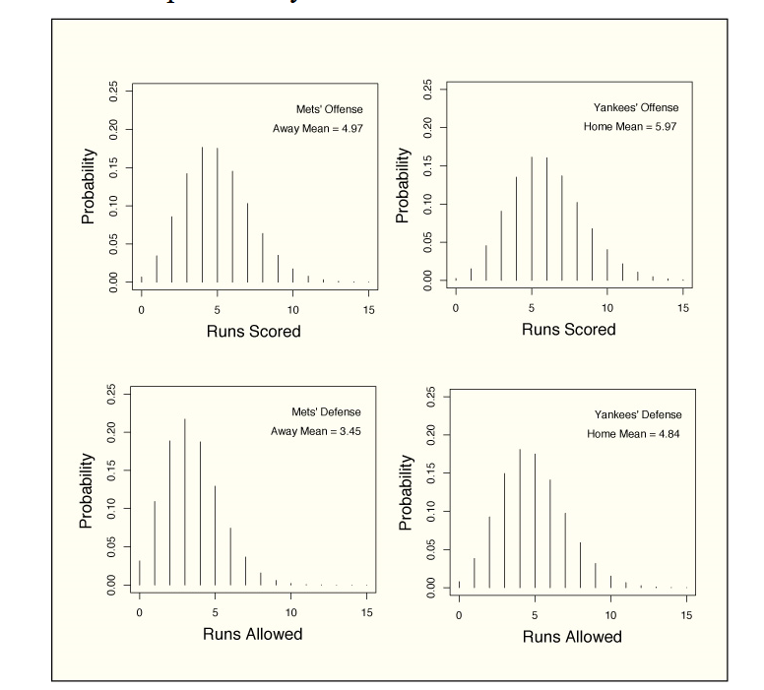
Poisson Model for Mets vs. Yankees at Yankee Stadium

Slide 17
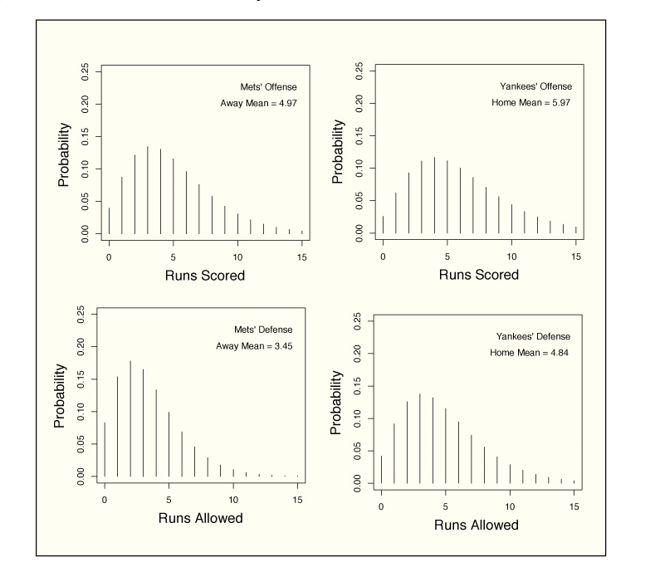
Negative Binomial Model for Mets vs. Yankees at Yankee Stadium

Slide 18
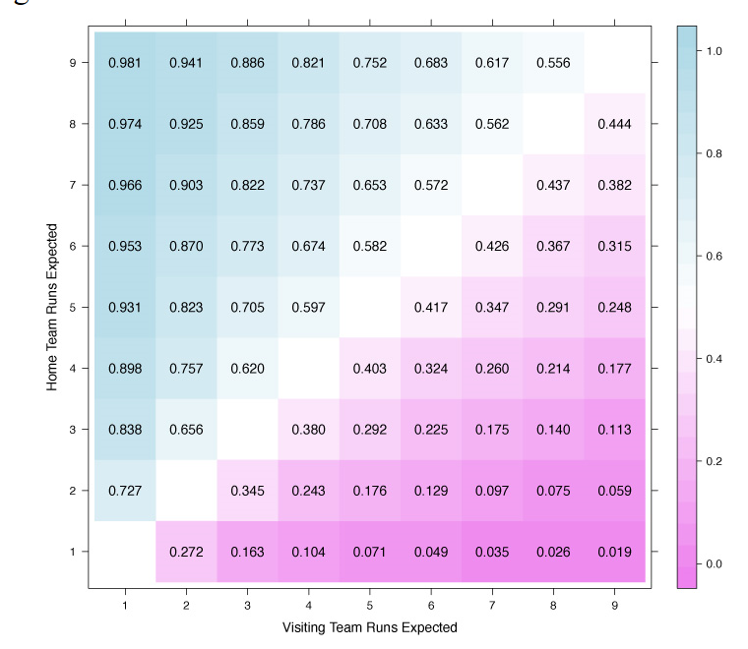
Probability of Home Team Winning (Negative Binomial Model)

